Slide 1
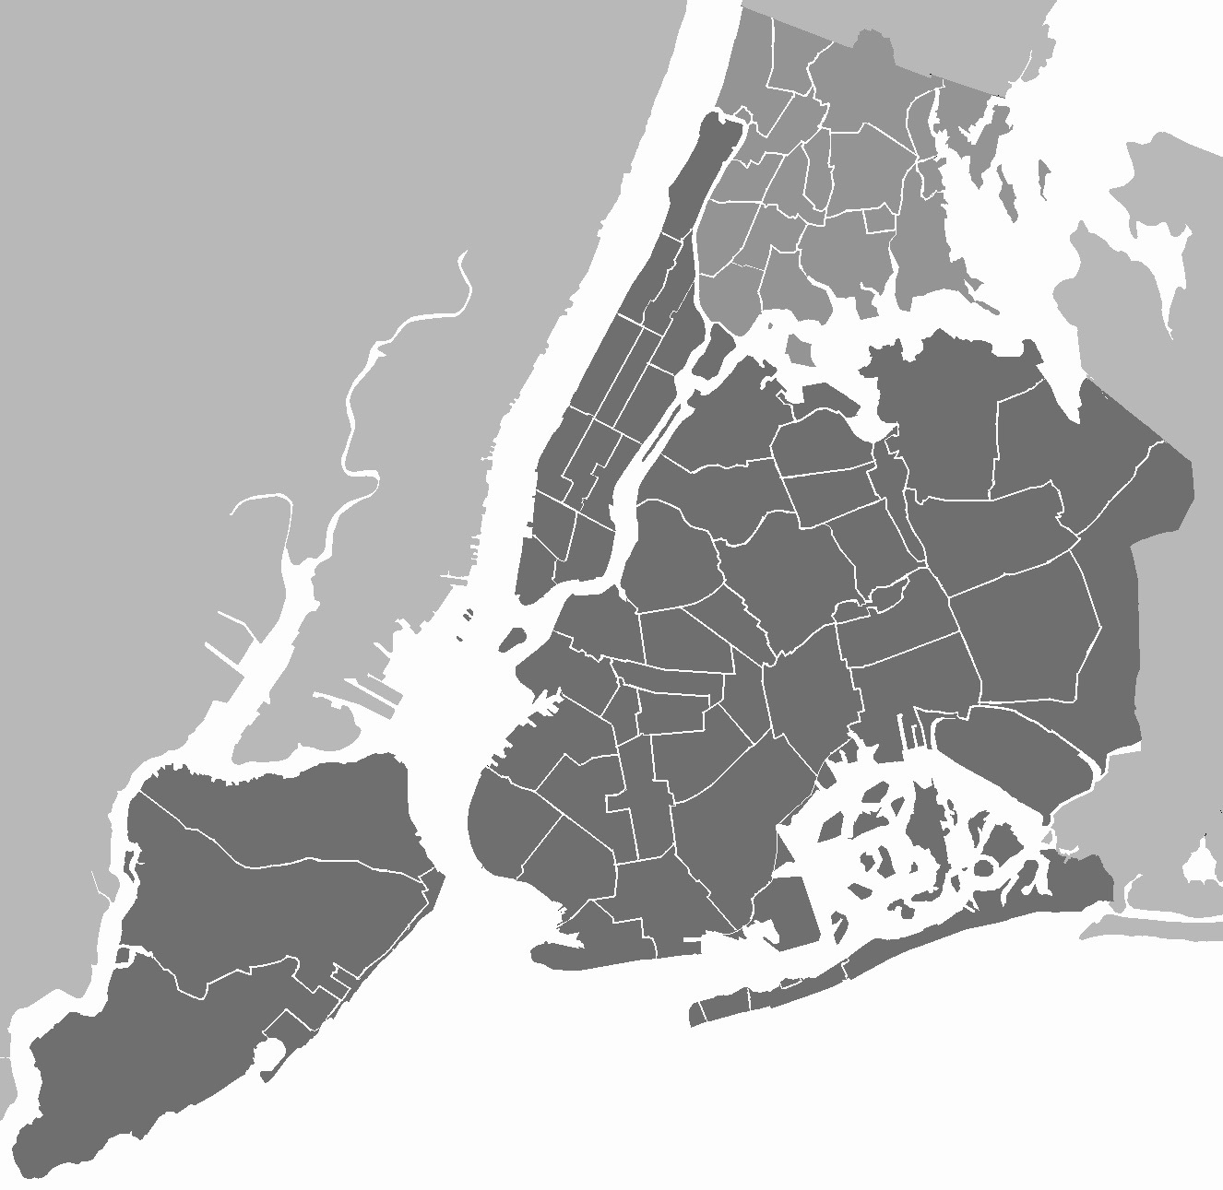
NYC Airbnb Data
2019 Data
Alejandro Olmedo
Alina Wang
Arda Dinc
David Huang
Manuel Soto

Slide 2
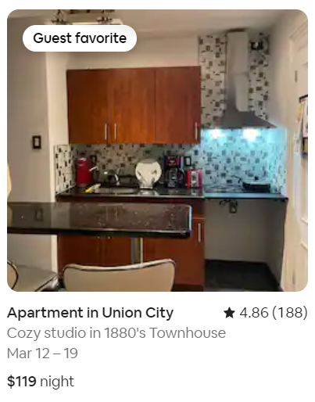
Why Explore This Data?
Renters would like to have a solid idea of expected rental rates
Understanding rental rates analogous to the surrounding area is crucial for catering to renters
Discovering the factors being influential for the price ranges
NYC Airbnb Guest Favorite Rental
Notes:
Everyone should have the general idea of what rates will be higher in which locations around NYC
For landlords, it is important to understand what caters to the types of renters in your location
Perhaps it’s the naming, the # of reviews, location, or all of them that impact our prices

Slide 3
Our Problem
What aspects of the Airbnb most impact the rental price for our various room types?
Location? Minimum nights? Reviews? Availability?
In addition to price, what other aspects of the rental attract renters the most, and how can hosts use this information to their advantage?

Slide 4
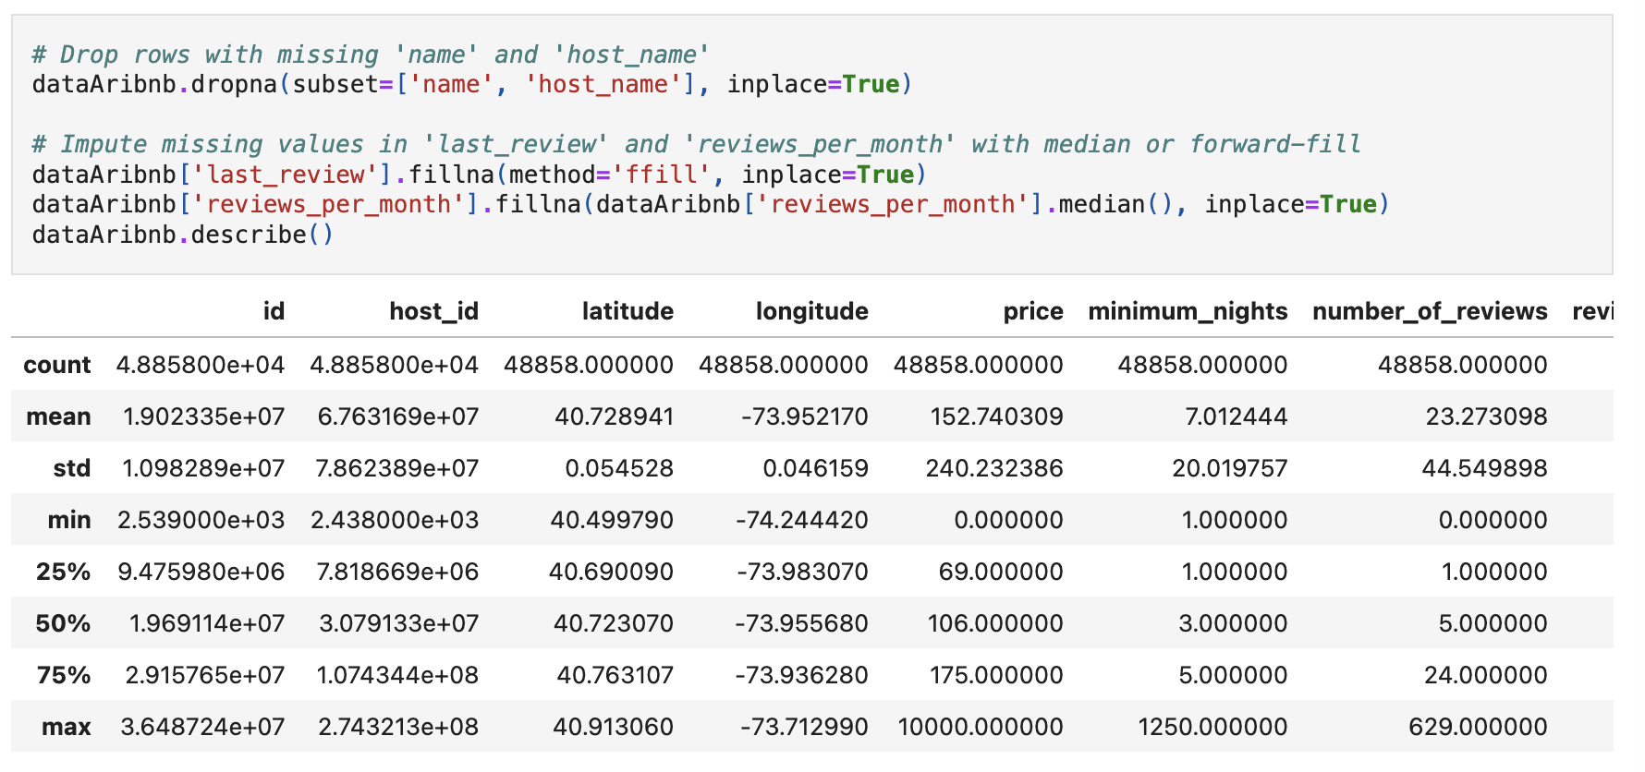
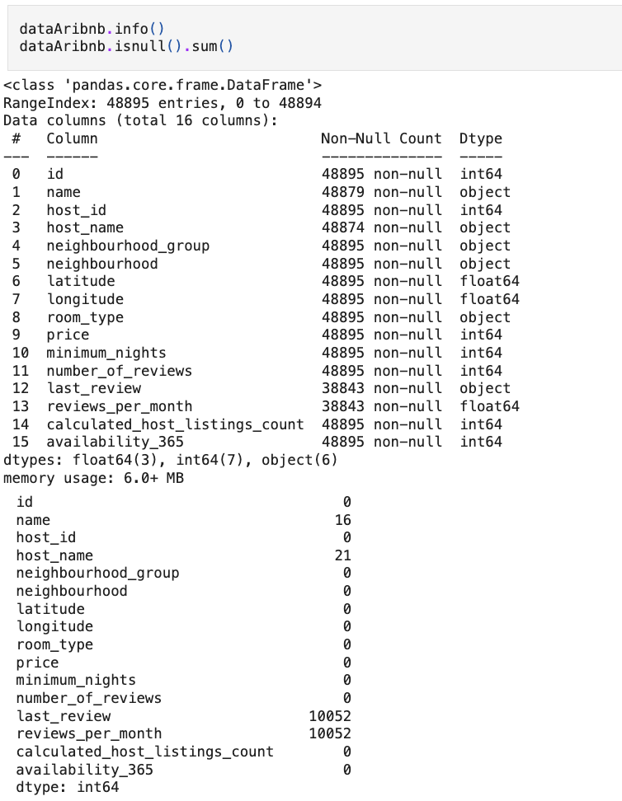
Exploratory Data Analysis
- Data Preprocessing

Slide 5
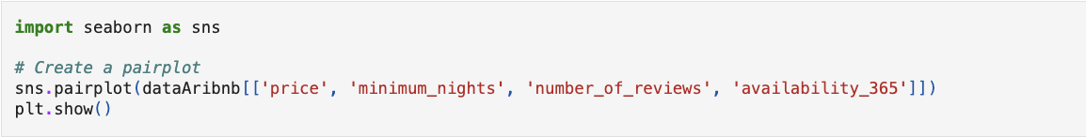

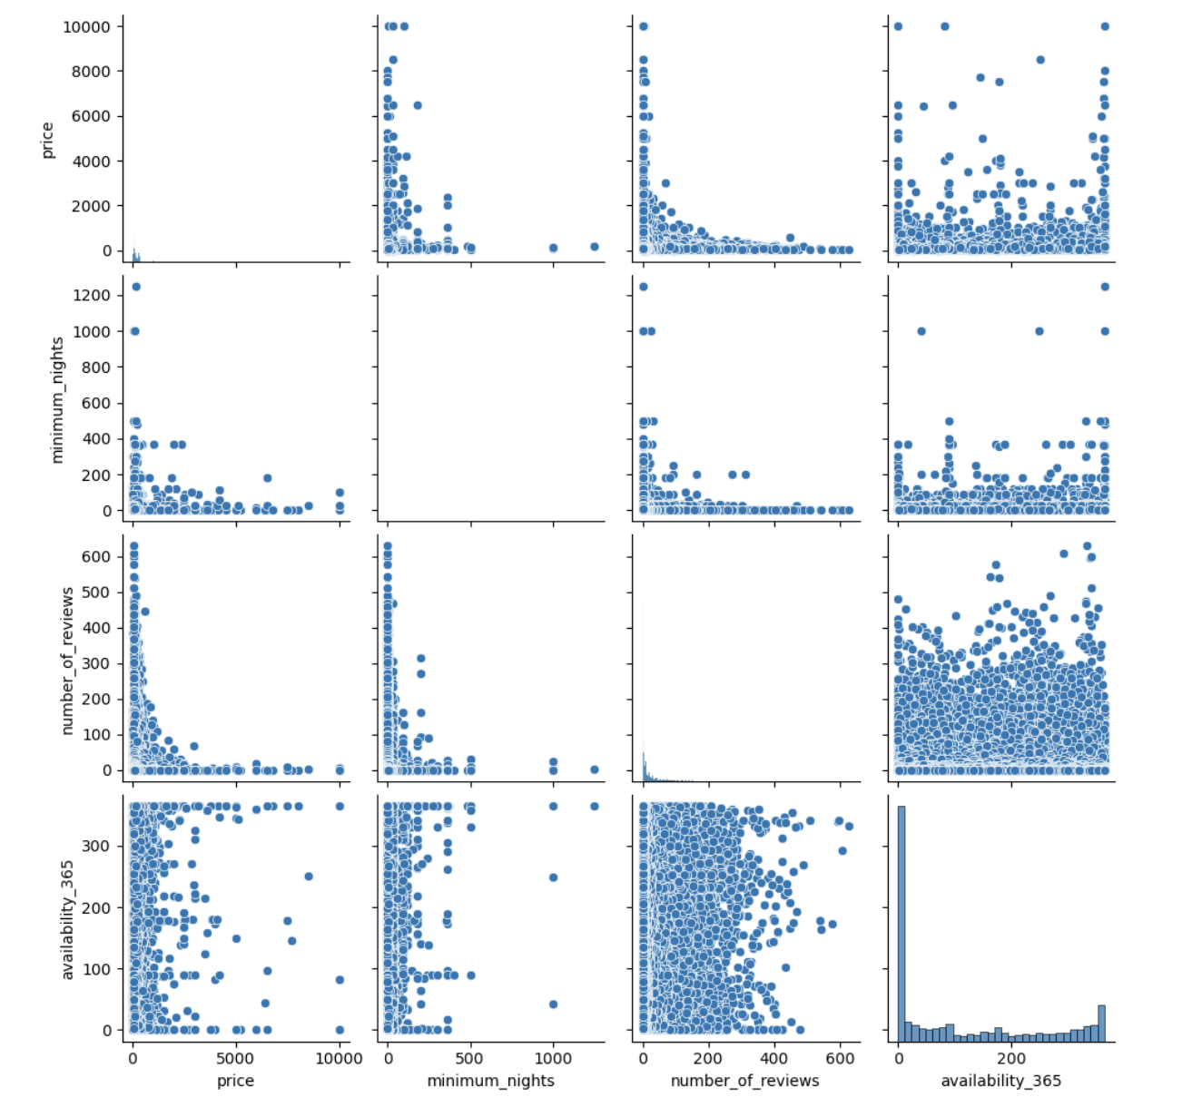
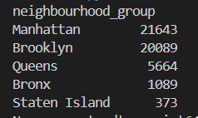
Exploratory Data Analysis
Correlation between different data - Pairplot
Most rentals in neighborhoods of Brooklyn & Manhattan
Notes:
Some models cannot tolerate missing data, thus we have to repair
We also want to validate some expectations
Can also verify relationships between availability & reviews, room type and price, etc

Slide 6
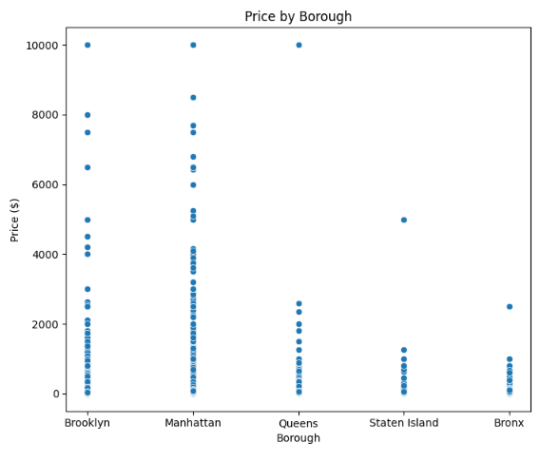
Exploratory Data Analysis Overview 1
Prices by each Neighborhood Group
Most rentals hover under $2,000.00 USD
Most expensive rentals are all within Brooklyn and Manhattan
Possibly skewed data towards Brooklyn and Manhattan?
Identify Patterns between Borough/Neighborhood to Price
Dot Plot of the Prices by Borough (2019)
Notes:
This data gives us an idea of what we’re working with

Slide 7
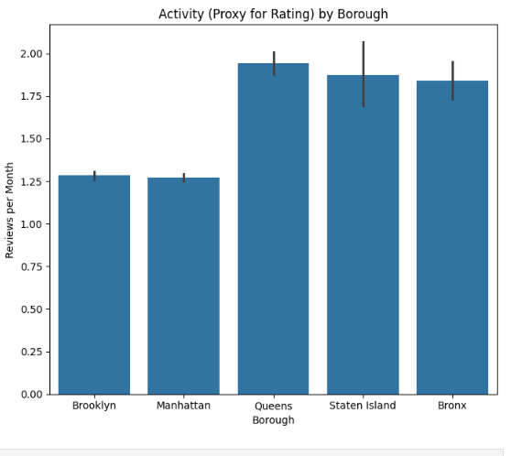
Exploratory Data Analysis Overview 2
Rating Activity by Neighborhood Group
Most rentals seem to have only one to two reviews a month
Queens, Staten Island, and Bronx all have greater review activity than Brooklyn and Manhattan…
Bar Graph of the Review Activity (2019)

Slide 8
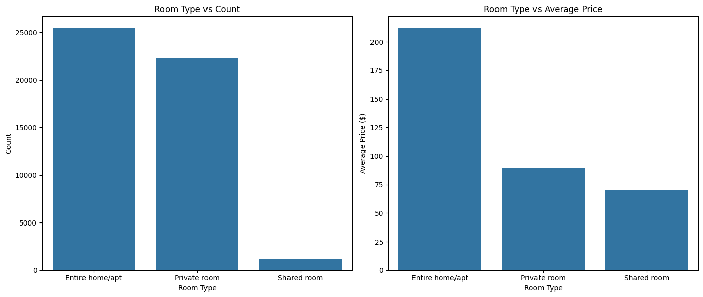
Exploratory Data Analysis Overview 3
Count (#) by each Room Type
The majority of Airbnb’s tend to be entire homes/apartments and private rooms.
Only ~5% of Airbnbs in NYC are shared rooms
Bar Graph of Count per Room Type (2019)

Slide 9
Exploratory Data Analysis Overview 4
Average Price ($) by Room Type
The average price of a single night at an entire home/apt tends to be approximately $225
More than 2x compared to private rooms (approx. $90)
Almost 3x compared to shared rooms (approx. $75)
Bar Graph of Avg Price per Room Type (2019)
Notes:
ao

Slide 10
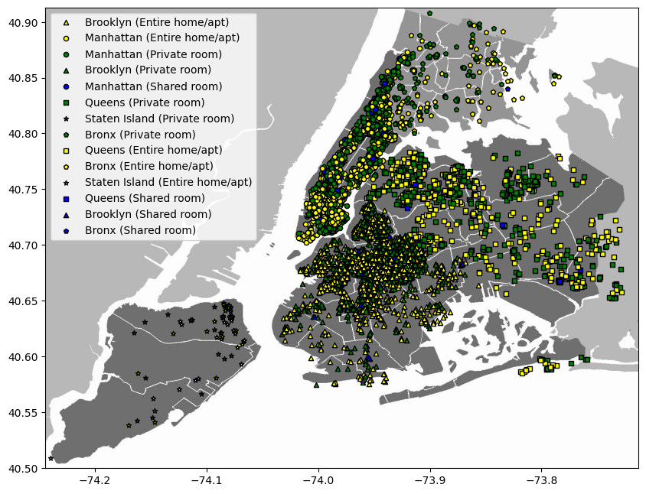
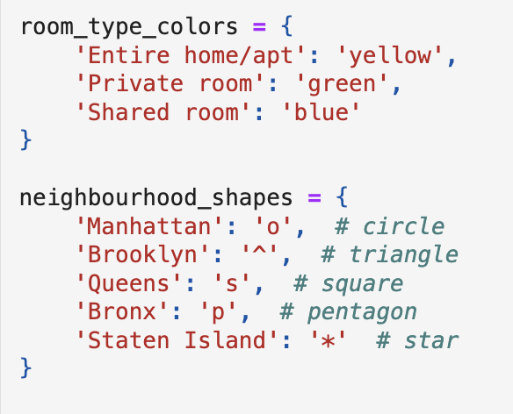
Exploratory Data Analysis Overview 5
Distribution of Room Types by Borough (Map)
Most Popular Airbnb’s are located in Manhattan, Brooklyn
Map of Room Type Distribution (2019)

Slide 11
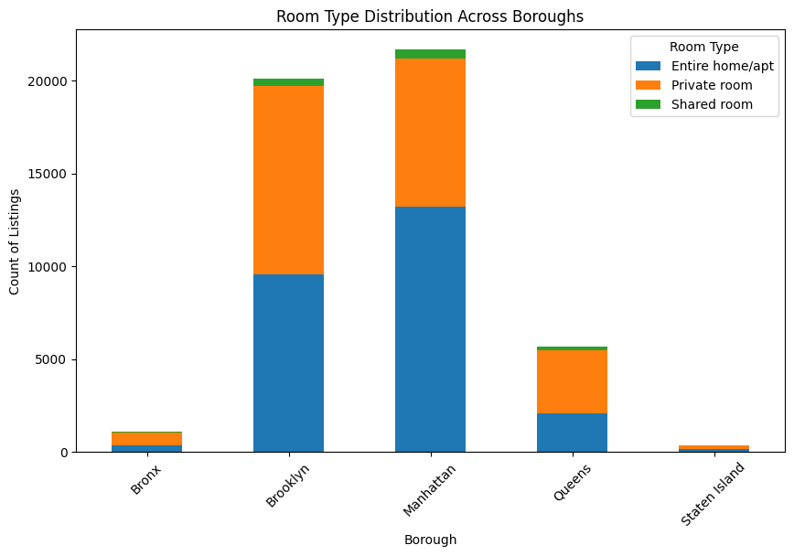
Exploratory Data Analysis Overview 5
Distribution of Room Types by Borough (Bar Graph)
Manhattan contains the largest # of home/apartments & shared rooms
Brooklyn contains the largest # of private rooms
Bar Graph of Room Type Distribution (2019)

Slide 12
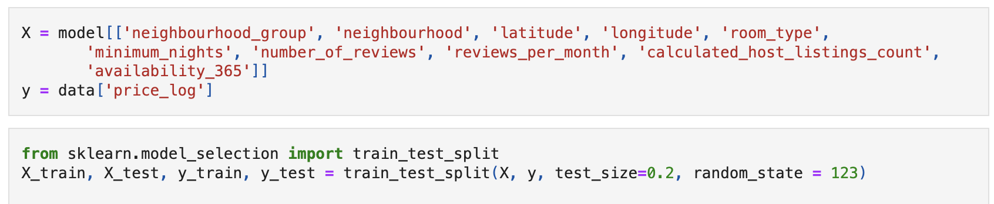
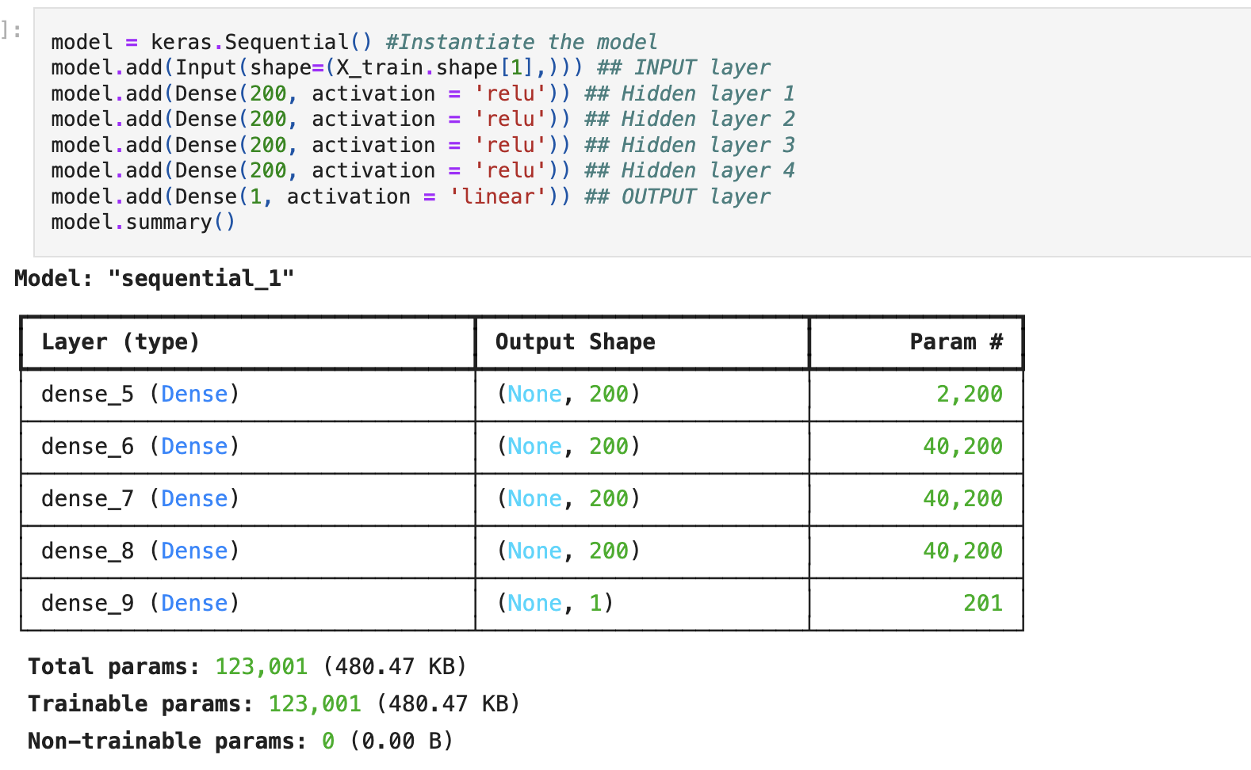
Building Our Model - Price Predictions
We split data into training set & test set, training set to train the model whilst test set is used to evaluate model performance (Using hypothesized factors)
Create a deep learning model with four hidden layers and one output layer

Slide 13
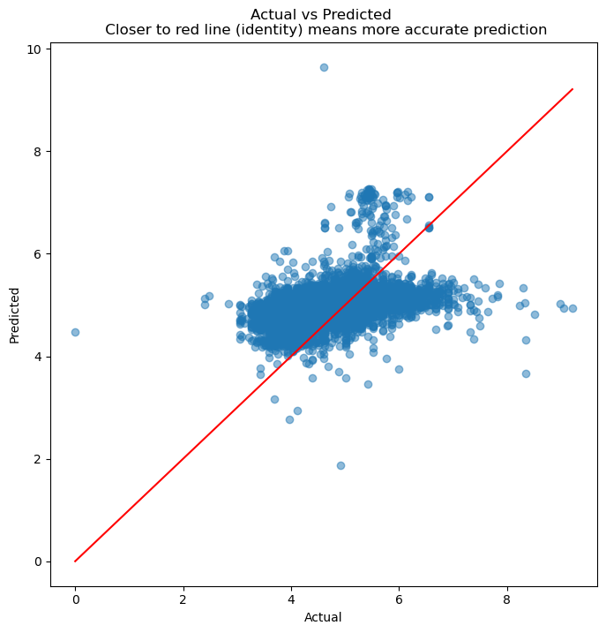
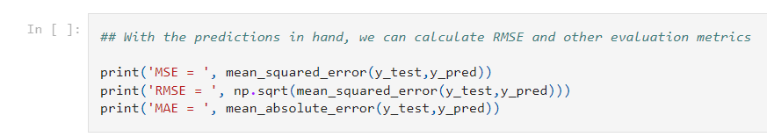

Building Our Model - model evaluation
we scatterplot the actuals against the predictions
*lower MSE indicates predicted values closer to actual values on average
Notes:
We do a train test split, splits data into training set & test set, training set to train the model whilst test set is used to evaluate model performance

Slide 14
Connecting Data Relations to Problem
Location is a crucial factor
Rental price varies significantly by borough, however Manhattan has the highest price points
Number of reviews can be seen as an indicator of popularity, giving Manhattan the highest review activity, which might correlate with higher prices due to higher demand
Room type is another crucial factor
Entire homes/apartments are the most listed type, followed by private homes
Entire homes/apartments also have the highest prices, indicating that customers value privacy
Notes:
ao

Slide 15
Insights on Attracting Renters
Space and Privacy
Offering more space and privacy increases the number of renters and amount they are willing to pay
Location and Popularity
Being located in desirable/central locations like Manhattan increases demand and cost

Slide 16
How Hosts Can Use This Information
Strategic Airbnb Locations
Hosting at specific broughts such as Manhattan and Brooklyn brings in more renters and allow you to place higher costs.
Host at less popular boroughs can offer more amenities/experiences to compensate for a less desirable location
Improve Listings
Hosts can focus on getting positive reviews to increase listing attractiveness and higher turnover rates
Emphasizing attributes such as privacy, space, and location that matter most to renters can attract more interest
Competitive Pricing
Hosts can set competitive prices based on their location to gather more renters and longer stays

Slide 17
Works Cited
Dataset from AirBnB: http://insideairbnb.com/get-the-data https://www.airbnb.com/new-york-ny/stays
Github Repository: https://github.com/Arda-Dinc04/Airbnb-Project/blob/main/Test.ipynb

Slide 18
Thanks for Listening!
Alejandro Olmedo, Alina Wang, Arda Dinc ,David Huang, Manuel Soto

